Slide 1


ETHERNET
FAST ETHERNET
GIGABIT ETHERNET

Slide 2
IEEE STANDARDS:
In 1985,the computer society of the IEEE started a project called , Project 802,to set standards to enable intercommunication among equipment from a variety of manufactures . Project 802 does not seek to replace any part of the OSI or the Internet model . Instead , it is away of specifying functions of the physical layer and the data link layer of major LAN protocols.
The IEEE has subdivided the data link layer into two sublayers : Logical link control
(LLC)and media access control(MAC).IEEE has also created several physical layer standards for different LAN protocols.

Slide 3
What is Ethernet?
Ethernet is a family of computer networking technologies for local area networks (LANs) and metropolitan area networks (MANs). It was commercially introduced in 1980 and first standardized in 1983 as IEEE 802.3,^{[1]} and has since been refined to support higher bit rates and longer link distances.
Over time, Ethernet has largely replaced competing wired LAN technologies such as token ring, FDDI, and ARCNET

Slide 4












ETHERNET EVOLUTION
STANDARD ETHERNET
FAST ETHERNET
GIGABIT ETHERNET
TEN GIGABIT ETHERNET
10Mbps
100Mbps
1Gbps
10Gbps

Slide 5
IEEE STANDARD FOR
LANs
LLC : Logical link control
MAC :Media access control
Upper Layers
Data link layer
Physical Layer
Transmission medium (OSI/Internet model)
Upper layers
 | LLC
Ethernet MAC | Token Ring MAC | Token Bus MAC | …
Ethernet Physical Layers (several) | Token Ring Physical Layer | Token Bus Physical Layer | …
 | Transmission Medium (IEEE STANDARD)
- - -
- - -

Slide 6
MAC Sublayer : In standard Ethernet , the MAC sublayer ,governs
the operation of the access method . And it also frames data received
from the upper layer and passes them to the physical layer.
FRAME FORMAT
The Ethernet frames contains seven fields : preamble ,SFD ,DA ,SA ,length or type of protocol data unit(PDU),upper-layer data ,the CRC . Ethernet does not provide any mechanism for acknowledging received frames , making it what is known as an unreliable medium . Acknowledgement must be implemented at the higher layers . The format of the MAC frame is shown in fig.
802.3 MAC frame:
Preamble:56 bits if alternating 1s and 0sSFD:Strat frame delimiter ,flag(10101011)
Preamble | SFD | Destination address | Source address | Length/Type | Data and padding | CRC
7bytes
1byte
6 bytes
6bytes
2bytes
4bytes
Physical layer header

Slide 7
PREAMBLE:The first field of the 802.3 frame contains 7 bytes(56bits )of alternating 0s and 1s that alerts the receiving system to coming frame and enables it to synchronize its input timing.
START FRAME DELIMITER(SFD):The second field (1byte:10101011)signals the beginning of the frame . The SFD warns the station that this is the last chance for synchronization . The last 2 bits is11 and alerts the receive that the next field is the destination address.
DESTINATION ADDRESS(DA):The DA field is 6bytes and contain the physical address of the destination station to receive the packet
SOURCE ADDRESS : The SA field is also 6 bytes and contains the physical address of the sender of the packet.
LENGTH/TYPE : This field is defined as a type field or length field.Theoriginal Ethernet used this field as the type field to define the upper –layer protocol using the MAC frame.
DATA : This field carries data encapsulated from the upper –layer protocols.It is a minimum of 46 and a maximum of 1500 bytes.
CRC : The last filed contains error detection information,in this case a CRC-32.

Slide 8
FRAME LENGTH : Ethernet has imposed restriction on both the minimum and maximum lengths of a frame , as shown below
Destination address | Source address | Length PDU | Data and padding | CRC
6 bytes
6 bytes
2 bytes
Minimum frame length :512bits or 64 bytes Maximum frame length:12,144bits/1518 bytes
4 bytes
REQUIREMENT OF MIN/MAX LENGTH:
The minimum length is required for the correct operation of CSMA/CD.
The maximum length is used to reduce the size of the buffer.
It also prevents one station from monopolizing the shared medium.

Slide 9
ADDRESSING : Each station on a Ethernet network(such as PC ,workstation or printer) has its own network interface card(NIC).The NIC fits inside the station and provides the station with a 6-byte physical address . The Ethernet address is 6bytes(48 bits)written in hexadecimal notation , with a colon between the bytes.
Example: 06:01:02:01:2C:4B
6bytes =12 hex digits=48 bits
UNICAST AND MULTICAST
ADUDnRicaEstS:S0;EmSult:icast:1
. . .
.
Byte 1 Byte 2 Byte 6
The least significant bit of the first byte defines the type of address . If the bit is 0 ,the address is unicast ; otherwise , it is multicast.
A unicast address defines only one recipient ; the relationship between the sender and the receiver is one-to-one.
A multicast address defines a group of addresses ; the relationship between the sender and the receiver is one-to-many.
The broadcast destination address is a special case of the multicast address in which all bits are 1s.

Slide 10
ACCESS METHOD:CSMA/CD
Standard Ethernet uses 1-persistent CSMA/CD
SLOT TIME:
Slot time=round-trip time + time required to send the jam sequence
RELATIONSHIP BETWEEN SLOT TIME AND MAXIMUM NETWORK LENGTH:
Max Length=Propagation speed ×slot time
2

Slide 11
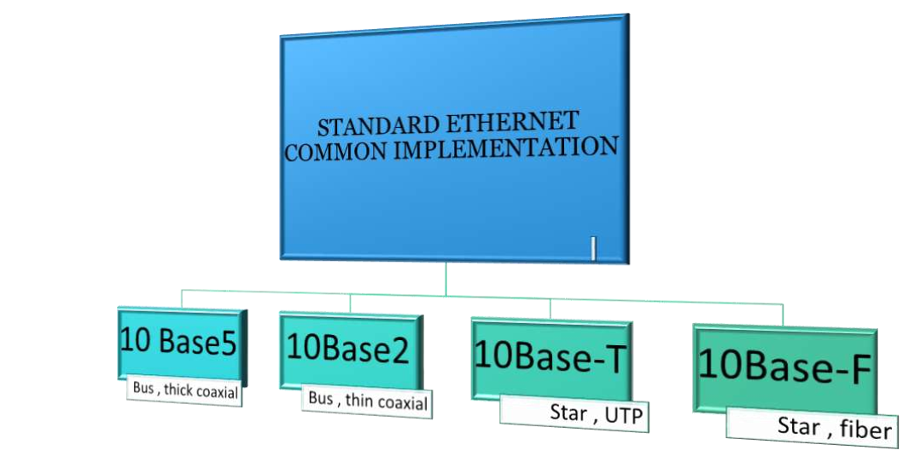

Slide 12








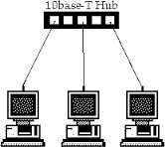
10Base-T:Twister Pair Ethernet
The third implementation is called 10Base- T or Twisted Pair Ethernet.
It uses star topology and the station are connected via two pairs of twisted cable(one fro sending and one for receiving)between the station and the hub.
The maximum length of the twisted cable here is defined as 100m,to minimize the effect of attenuation in the twisted cable.

Slide 13







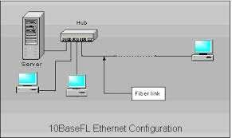
10Base-F:Fiber Ethernet
Although there are several types of optical fiber 10Mbps Ethernet
, the most common is called
10Base-F.
10Base-F uses a star topology to connect stations to a hub.
The stations are connected to a hub using two-optic cables.

Slide 14

It was designed to compete with LAN protocols such as FDDI or Fiber channel . IEEE created Fast Ethernet under the name 802.3u.Fast Ethernet is backward-compatible with standard Ethernet , but it can transmit data 10 times faster at rate of100Mbps.
Upgrade the data rate to 100Mbps.
Make it compatible with standard Ethernet.
Keep the same 48 bit-address.
Keep the same frame format.
Keep the same minimum and maximum frame lengths.

Slide 15


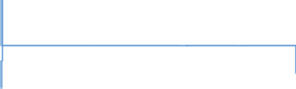






COMMON FAST ETHERNET IMPLEMENTATI ON
100Base-TX
100Base-FX
Two wires fiber
10Base-T4
Four wires category 3UTP
Two wires category
5UTP

Slide 16
Upgrade the data rate to 1Gbps.
Make it compatible with standard or fast Ethernet.
Use the same address ,frame format.
Keep the same minimum and maximum frame length.
To support auto negotiation as defined in Fast Ethernet.

Slide 17
GIGABIT ETHERNET IMPLEMENTATION
1000Base-SX
1000Base-LX
1000Base-CX
1000Base-T
Two wire
Shortwave fiber
Two-wire
Long –wave fiber
Two-wire
Copper(STP)
Four-wire
UTP

Slide 18
SUMMARY FOR GIGABIT ETHERNET IMPLEMENTATION
Name | Medium | Specified distance
1000BASE-CX | Shielded balanced copper cable | 25 meters
1000BASE-KX | Copper backplane | 1 meter
1000BASE-SX | Multi-mode fiber | 220 to 550 meters dependent on fiber diameter and bandwidth
1000BASE-LX | Multi-mode fiber | 550 meters
1000BASE-LX | Single-mode fiber | 5 km
1000BASE-LX10 | Single-mode fiber using 1,310 nm wavelength | 10 km
1000BASE-EX | Single-mode fiber at 1,310 nm wavelength | ~ 40 km
1000BASE-ZX | Single-mode fiber at 1,550 nm wavelength | ~ 70 km
1000BASE-BX10 | Single-mode fiber, over single-strand fiber: 1,490 nm downstream 1,310 nm upstream | 10 km
1000BASE-T | Twisted-pair cabling (Cat-5, Cat-5e, Cat-6, Cat-7) | 100 meters
1000BASE-TX | Twisted-pair cabling (Cat-6, Cat-7) | 100 meters

Slide 19
Notable IEEE Standards formats
IEEE 802
LAN/MAN
Standards for LAN/MAN bridging and management and remote media access control (MAC) bridging.
IEEE 802.1
IEEE 802.2
Standards for Logical Link Control (LLC) standards for connectivity.
Ethernet Standards for Carrier Sense Multiple Access with Collision Detection (CSMA/CD).
IEEE 802.3
IEEE 802.4
Standards for token passing bus access.
IEEE 802.24
Standards for Logical Link Control (LLC) standards for connectivity.
Standards for token ring access and for communications between LANs and MANs
IEEE 802.5
IEEE 802.6
Standards for information exchange between systems.
IEEE 802.7
Standards for broadband LAN cabling.
IEEE 802.8
Fiber optic connection.

Slide 20
IEEE 802.9 | Standards for integrated services, like voice and data.
IEEE 802.10 | Standards for LAN/MAN security implementations.
IEEE 802.11 | Wireless Networking – "WiFi".
IEEE 802.12 | Standards for demand priority access method.
IEEE 802.14 | Standards for cable television broadband communications.
IEEE 802.15.1 | Bluetooth
IEEE 802.15.4 | Wireless Sensor/Control Networks – "ZigBee"
IEEE 802.15.6 | Wireless Body Area Network^{[3]} (BAN) – (e.g. Bluetooth low energy)
IEEE 802.16 | Wireless Networking – "WiMAX"

Slide 21

IEEE 802 refers to a family of IEEE standards dealing with local area networks and metropolitan area networks. More specifically, the IEEE 802 standards are restricted to networks carrying variable-size packets. (By contrast, in cell relay networks data is transmitted in short, uniformly sized units called cells. Isochronous networks, where data is transmitted as a steady stream of octets, or groups of octets, at regular time intervals, are also out of the scope of this standard.)
The services and protocols specified in IEEE 802 map to the lower two layers (Data Link and Physical) of the seven-layer OSI networking reference model. In fact, IEEE 802 splits the OSI Data Link Layer into two sub-layers named Logical Link Control (LLC) and Media Access Control (MAC), so that the layers can be listed like this:
Data link layer
  LLC Sublayer
  MAC Sublayer
Physical layer

Slide 22
Working groups:
Name | Description | Note
IEEE 802.1 | Bridging (networking) and Network Management
IEEE 802.2 | LLC | inactive
IEEE 802.3 | Ethernet
IEEE 802.4 | Token bus | disbanded
IEEE 802.5 | Defines the MAC layer for a Token Ring | inactive
IEEE 802.6 | MANs (DQDB) | disbanded
IEEE 802.7 | Broadband LAN using Coaxial Cable | disbanded
IEEE 802.8 | Fiber Optic TAG | disbanded
IEEE 802.9 | Integrated Services LAN (ISLAN or isoEthernet) | disbanded
IEEE 802.10 | Interoperable LAN Security | disbanded
IEEE 802.11 | Wireless LAN (WLAN) & Mesh (Wi-Fi certification)
IEEE 802.12 | 100BaseVG | disbanded
IEEE 802.13 | Unused | Reserved for Fast Ethernet development
IEEE 802.14 | Cable modems | disbanded

Slide 23
IEEE 802.15 | Wireless PAN
IEEE 802.15.1 | Bluetooth certification
IEEE 802.15.2 | IEEE 802.15 and IEEE 802.11 coexistence
IEEE 802.15.3 | High-Rate wireless PAN (e.g., UWB, etc.)
IEEE 802.15.4 | Low-Rate wireless PAN (e.g., ZigBee, WirelessHART, MiWi, etc.)
IEEE 802.15.5 | Mesh networking for WPAN
IEEE 802.15.6 | Body area network
IEEE 802.16 | Broadband Wireless Access (WiMAX certification)
IEEE 802.16.1 | Local Multipoint Distribution Service
IEEE 802.17 | Resilient packet ring
IEEE 802.18 | Radio Regulatory TAG
IEEE 802.19 | Coexistence TAG
IEEE 802.20 | Mobile Broadband Wireless Access
IEEE 802.21 | Media Independent Handoff
IEEE 802.22 | Wireless Regional Area Network
IEEE 802.23 | Emergency Services Working Group
IEEE 802.24 | Smart Grid TAG | New (November, 2012)
IEEE 802.25 | Omni-Range Area Network | Not yet ratified

Slide 24
IEEE 802.3
IEEE 802.3 is a working group and a collection of IEEE standards produced by the working group defining the physical layer and data link layer's media access control (MAC) of wired Ethernet. This is generally a local area network technology with some wide area network applications.
Physical connections are made between nodes and/or infrastructure devices (hubs, switches, routers) by various types of copper or fiber cable.
802.3 is a technology that supports the IEEE 802.1 network architecture.
802.3 also defines LAN access method using CSMA/CD.

Slide 25
COMMUNICATION STANDARDS
802.3-2012 | 2012 | A revision of base standard incorporating the 802.3at/av/az/ba/bc/bd/bf/bg amendments, a corrigenda and errata.
802.3bj | June 2014 | Define a 4-lane 100 Gbit/s backplane PHY for operation over links consistent with copper traces on “improved FR-4” (as defined by IEEE P802.3ap or better materials to be defined by the Task Force) with lengths up to at least 1m and a 4-lane 100 Gbit/s PHY for operation over links consistent with copper twinaxial cables with lengths up to at least 5m.
802.3bk | 2013 | This amendment to IEEE Std 802.3 defines the physical layer specifications and management parameters for EPON operation on point-to-multipoint passive optical networks supporting extended power budget classes of PX30, PX40, PRX40, and PR40 PMDs.
802.3bm | 2015 | 100G/40G Ethernet for optical fiber
802.3bp | 2014 | 1000BASE-T1 - Gigabit Ethernet over a single twisted pair, automotive & industrial environments
802.3bq | ~Feb 2016 | 40GBASE-T for 4-pair balanced twisted-pair cabling with 2 connectors over 30 m distances
802.3bs | ~ 2017 | 400 Gbit/s Ethernet over optical fiber using multiple 25G/50G lanes
802.3bt | ~ 2017 | Power over Ethernet enhancements up to 100W using all 4-pairs balanced twisted-pair cabling, lower standby power and specific enhancements to support Iot applications (e.g. Lighting, sensors, building automation).

Slide 26
Token Ring/IEEE 802.5
The Token Ring network was originally developed by IBM in the 1970s. It is still in IBM's primary local-area network (LAN) technology. The related IEEE
802.5 specification is almost identical to and completely compatible with IBM's Token Ring network.
Token Ring and IEEE 802.5 networks are basically compatible, although the specifications differ in minor ways. IBM's Token Ring network specifies a star, with all end stations attached to a device called a multi station access unit (MSAU). In contrast, IEEE 802.5 does not specify a topology, although virtually all IEEE 802.5 implementations are based on a star.

Slide 27
TOKEN PASSING PROTOCOLS
Before workstation can transmit it must possess the one and only token.
Two types:
  Token ring
  Token bus
27

Slide 28
TOKEN BUS : IEEE STANDARD 802.4
This standard 802.4(Dirvin and Miller and IEEE, 1986) described a LAN called a token bus.
A simple system in which stations takes turns sending a frame was introduced know as a TOKEN BUS SYSTEM.
The token bus is linear tree shaped cable onto which stations are attached.
Logically stations are organized into a ring with each station knowing the address of the station to its left and right.
During logical ring initialization the highest number station may send the first frame.
28

Slide 29
TOKEN RING
IBM created TOKEN RINGS to compete with DIX (DEC/Intel/Xerox) standard of Ethernet to improve upon its previous token bus technology.
29

Slide 30
IEEE 802.5 TOKEN RING
Proposed in 1969 and initially referred to as a Newhall ring.
Token ring :: a number of stations connected by transmission links in a ring topology. Information flows in one direction along the ring from source to destination and back to source. Can both be implemented using star as well as ring topologies but basically it uses ring topology logically and star topology physically.
Medium access control :: is provided by a small frame, the token, that circulates around the ring when all stations are idle. Only the station possessing the token is allowed to transmit at any given time.
30

Slide 31
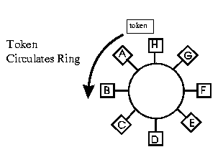
IEEE 802.5 TOKEN RING
There is a point to point link between stations that form a ring.
Physical Layer Topology: Ring
  Stations connected in a loop
  Signals go in only one direction, station-to-station
In a token ring a special bit format calleda token circulated around all the stations.
31

Slide 32
TOKEN RING OPERATION
When a station wishes to transmit, it must wait for the token to pass by and seize the token.
  One approach: change one bit in token which transforms it into a
normal data frame and appends frame for transmission.
  Second approach: station claims token by removing it from the ring.
The data frame circles the ring and is removed by the transmitting station.
Each station interrogates passing frame. If destined for station, it copies the frame into local buffer.
32

Slide 33
Token Frame Format
Access Control
(1 Byte)
S | AC | E
(1 Byte)
Start Frame Delimiter
(1 Byte)
End Frame Delimiter
P | P | P | T | M | R | R | R
Priority Bits
000 – lowest
111 - highest
Token Bit
0 – Token frame 1 – nontoken frame
Reservation Bits 3-bit field used for reserving a token at a prescribed priority level
Monitor Bit
0 = “clean” frame
1 = “orphaned" frame

Slide 34
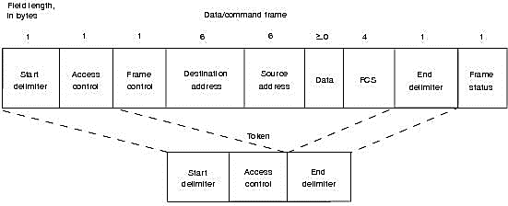
Frame Format
Token Ring and IEEE 802.5 support two basic frame types: tokens and data/command frames.
Figure: IEEE 802.5 and Token Ring Specify Tokens and Data/Command Frames.

Slide 35
Wireless LAN Technology
Wireless LAN Technology

Slide 36
WIRELESS LAN TECHNOLOGY
INFRARED LANs
SPREAD SPECTRUM LANs
NARROWBAND MICROWAVE

Slide 37
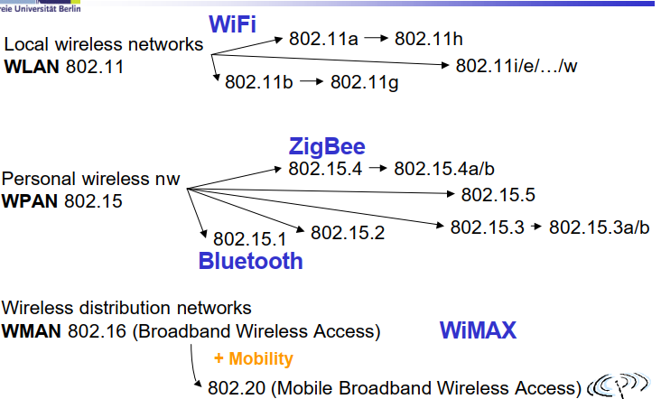

Slide 38
IEEE 802.11:
In 1990,the IEEE 802 committee formed a new working group , IEEE 802.11 specifically devoted to wireless LANs , with a character to develop a MAC protocol and physical medium specification.
The demand of the for WANs , at different frequencies and data rates,has exploded.
Keeping pace with demand ,the IEEE802.11 working group has issued an ever-expanding list of standards.

Slide 39
Within the IEEE 802.11 Working Group , the following IEEE Standards Association Standard and Amendments exist:
IEEE 802.11-1997: The WLAN standard was originally 1 Mbit/s and 2 Mbit/s, 2.4 GHz RF and infrared (IR) standard (1997), all the others listed below are Amendments to this standard, except for Recommended Practices 802.11F and 802.11T.
IEEE 802.11a: 54 Mbit/s, 5 GHz standard (1999, shipping products in 2001)
IEEE 802.11b: Enhancements to 802.11 to support 5.5 Mbit/s and 11 Mbit/s (1999)
IEEE 802.11c: Bridge operation procedures; included in the IEEE 802.1D standard (2001)
IEEE 802.11d: International (country-to-country) roaming extensions (2001)
IEEE 802.11F: Inter-Access Point Protocol (2003) _{Withdrawn February 2006}
IEEE 802.11g: 54 Mbit/s, 2.4 GHz standard (backwards compatible with b) (2003)
IEEE 802.11h: Spectrum Managed 802.11a (5 GHz) for European compatibility (2004)
IEEE 802.11i: Enhanced security (2004)
IEEE 802.11j: Extensions for Japan (2004)
IEEE 802.11-2007: A new release of the standard that includes amendments a, b, d, e, g, h, i, and j. (July 2007)
IEEE 802.11k: Radio resource measurement enhancements (2008)

Slide 40
Infrastructure vs. Ad hoc WLANs
infrastructure
network
AP: Access Point
AP
AP
wired network
AP
ad-hoc network
Source: Schiller

Slide 41
802.11 - ad-hoc network
802.11 LAN
STA₁
Direct communication within a limited range
  Station (STA):
  terminal with access mechanisms to the wireless medium
  Basic Service Set (BSS):
  group of stations using the same radio frequency
BSS₁
STA₃
STA₂
BSS₂
STA₅
STA₄
802.11 LAN
Source: Schiller

Slide 42
802.11 - infrastructure network
Station (STA)
  terminal with access mechanisms to the wireless medium and radio contact to the access point
Basic Service Set (BSS)
  group of stations using the same radio frequency
Access Point
  station integrated into the wireless LAN and the distribution system
Portal
  bridge to other (wired) networks
Distribution System
  interconnection network to form one logical network (EES: Extended Service Set) based
  on several BSS
802.11 LAN
802.x LAN
STA₁
BSS₁
Access
Point
Portal
Distribution System
ESS
Access
Point
BSS₂
STA₂
802.11 LAN
STA₃
Source: Schiller
Notes:
9

Slide 43
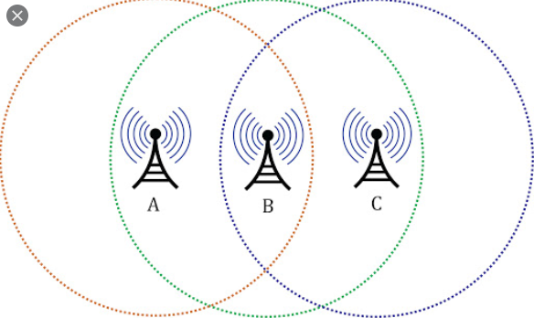
It is particularly important for wireless networks, where the collision detection of the alternative CSMA/CD is not possible due to wireless transmitters desensing their receivers during packet transmission.
  A and C cannot hear each other.
  A sends to B, C cannot receive A.
  C wants to send to B, C senses a “free” medium (CS fails)
  Collision occurs at B.
  A cannot receive the collision (CD fails).
  A is “hidden” for C.

Slide 44
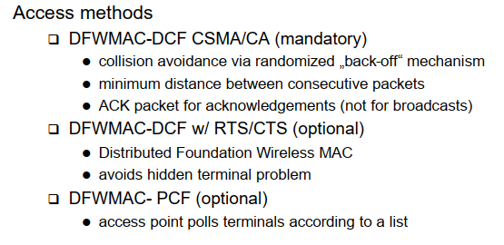

Slide 45
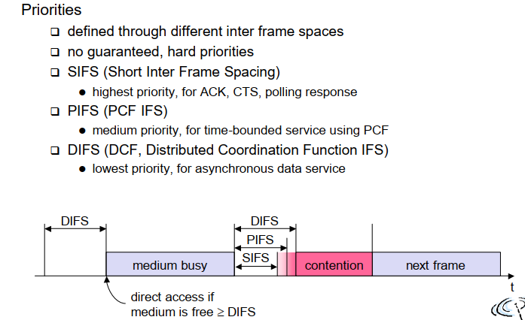

Slide 46
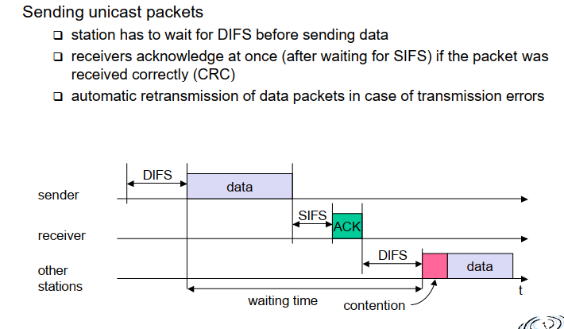

Slide 47
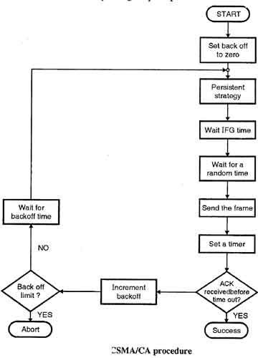

Slide 48
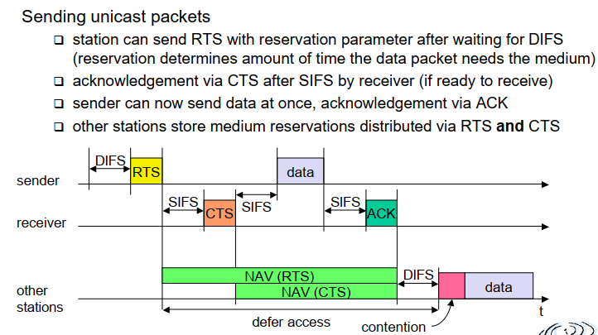

Slide 49
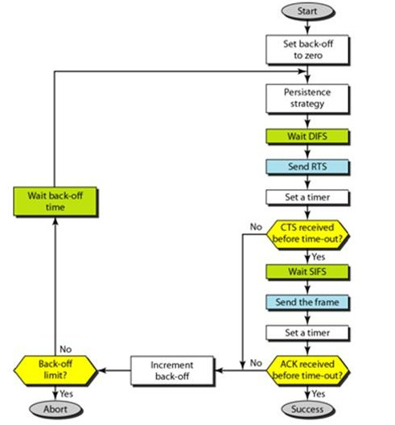
RTS-CTS

Slide 50
Solution to Hidden/Exposed Terminals
A first sends a Request-to-Send (RTS) to B
On receiving RTS, B responds Clear-to-Send (CTS)
Hidden node C overhears CTS and keeps quiet
  Transfer duration is included in both RTS and CTS
Exposed node overhears a RTS but not the CTS
  D’s transmission cannot interfere at B
RTS
RTS
D
A
B
C
CTS
CTS
DATA

Slide 51
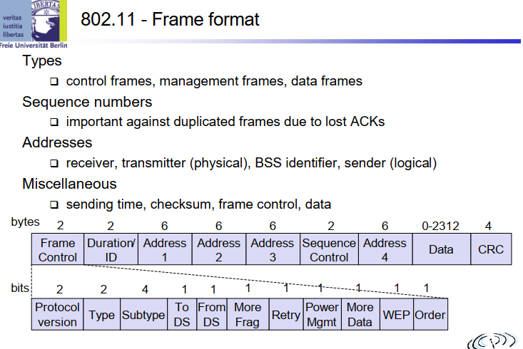

Slide 52
1 An Ethernet MAC sublayer receives 42 bytes of data from the upper layer. How many bytes of padding( 0’s will be added to equalize=46) must be added to the data?
2. An Ethernet MAC sublayer receives 1510 bytes of data from the upper layer. Can
the data be encapsulated in one frame? If not, how many frames need to be sent?
What is the size of the data in each frame?
3. Suppose the length of a lOBase5 cable is 2500 m. If the speed of propagation in a thick coaxial cable is 200,000,000 m!s, how long does it take for a bit to travel from the beginning to the end of the network?

